Slide 1
DAA Assignment 4 Group 3
Group members
Roll-No. Name Github ID
IIT2019009 | Abhijeet Sonkar | Abhijeet-sonkar
IIT2019007 | Aditya Raj | Adityahulk
IIT2019008 | Shyam Tayal | shyamTayal

Slide 2
Contents –
Problem Statement
Introduction
Algorithm Design and Analysis
Time and space complexity analysis
Conclusion
References

Slide 3
Introduction -
Dynamic Programming
Dynamic Programming is mainly an optimization over plain recursion. Wherever we see a recursive solution that has repeated calls for same inputs, we can optimize it using Dynamic Programming. The idea is to simply store the results of subproblems, so that we do not have to re-compute them when needed later. This simple optimization reduces time complexities from exponential to polynomial.
Steps of doing Dynamic Programming
Characterize the structure of an optimal solution.
Recursively define the value of an optimal solution.
Compute the value of an optimal solution in a bottom-up fashion.
Construct an optimal solution from computed information.

Slide 4
Problem Statement -
Given n friends, each one can remain single or can be paired up with some other friend. Each friend can be paired only once. Find out the total number of ways in which friends can remain single or can be paired up. Solve using Dynamic programming.

Slide 5
Algorithm Design and Analysis -
Implementing steps of Naive Algorithm:-
All possible combination of pair of n friends can be calculated with
the help n-1 and n-2 friends
We can solve this dependency with the help of recursion
The recursion dependency calculates n as pair(n-1)*((n-1)*pair(n-2))
Implementing steps of both Dynamic Programming:-
The dependency relationship for any recursion problem can be solved
using Dynamic Programming.
Here also for every recursion output,we can store it for future use,i.e
memoization.
The memoization output can also be calculated by iteration which gives linear
time complexity.

Slide 6
Time and space complexity analysis -
 | Time Complexity | Space Complexity
Naive Algorithm | O(2^n) | O(1)
Dynamic Programming1 | O(N) | O(N)
Dynamic Programming2 | O(N) | O(1)

Slide 7
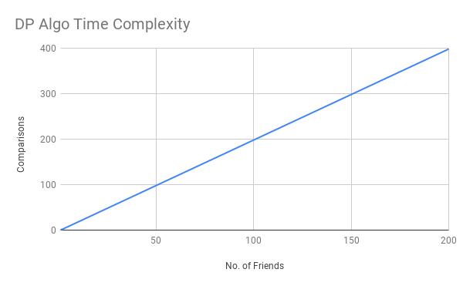
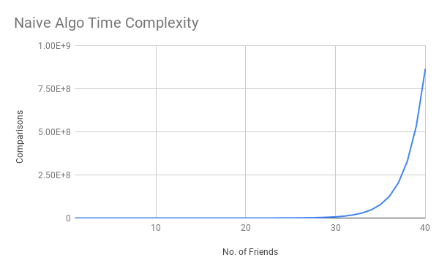
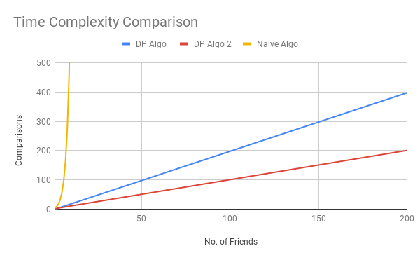

Slide 8
Conclusion
DP 2 is more efficient algorithm
The reason is both time complexity and space complexity equation
The second algorithm has O(N) i.e linear time dependency while first algorithm has
The main reason behind this is the use of Dynamic Programming also by iteration that reduces both time complexity and space complexity.
The recursion has time complexity problem but even DP1 i.e implemented by memoization has space occurrence which is not present in iterative version i.e DP2.

Slide 9
References
https://www.geeksforgeeks.org/dynamic-programming/
https://www.geeksforgeeks.org/tabulation-vs-memoization/

